Slide 1
UK COVID Analysis
LSE Data Analytics Module 2
7th July 2022

Slide 2
The UK Government has requested an analysis of collected COVID-19 data in order to help with a marketing campaign that increases the up-take of the COVID-19 vaccine.
The government have asked for the following:
Total vaccinations, including first and second dose up-take as well as across all regions
Where to target the campaign based on:
The largest area with 1st dose but no 2nd dose
Area with the greatest number of recoveries
If Deaths have peaked in any region
If there are any regions who have not yet peaked in hospitalisation numbers
What Twitter hashtags are trending
BRIEF

Slide 3
GIBRALTAR
EXPLORATION

Slide 4
Analysis was performed on a single table following the merging of 2 data sets:
UK Covid-19 Cases
UK Covid-19 Vaccinations
This provided the ability to look and compare all of the data in one place rather than performing the analysis in several.
Once the data was combined, it was loaded to GitHub so that it can be versioned correctly and accessed by anyone wishing to do their own analysis on the data.
It is important to note: an assumption was made that the data was cumulative rather than new records per day which, if the assumption is incorrect, will result in the numbers provided in this analysis also being incorrect.
Gibraltar Approach

Slide 5
Gibraltar Insights
Not all data points were obvious, especially when it comes to the actual integers which were populated.
Examples which would need further investigation and explanation are:
Column headers infer infection (Cases, Hospitalised) and a resolution (Recovered, Death) however there is no correlation between them.
There is a wave pattern in the data for hospitalisations which may, or may not, coincide with vaccination drives and/or new strains - so additional data points are required.
There is no indication of what the percentage of the Gibraltar population has actually caught COVID-19 and recovered. This would be a useful metric to overlay.
The last two records in the dataset are interesting as they indicate a failure to record rather than a sudden drop to 0. Additional data, if available, would be beneficial for continued trend analysis.

Slide 6
VACCINATION
UPTAKE

Slide 7
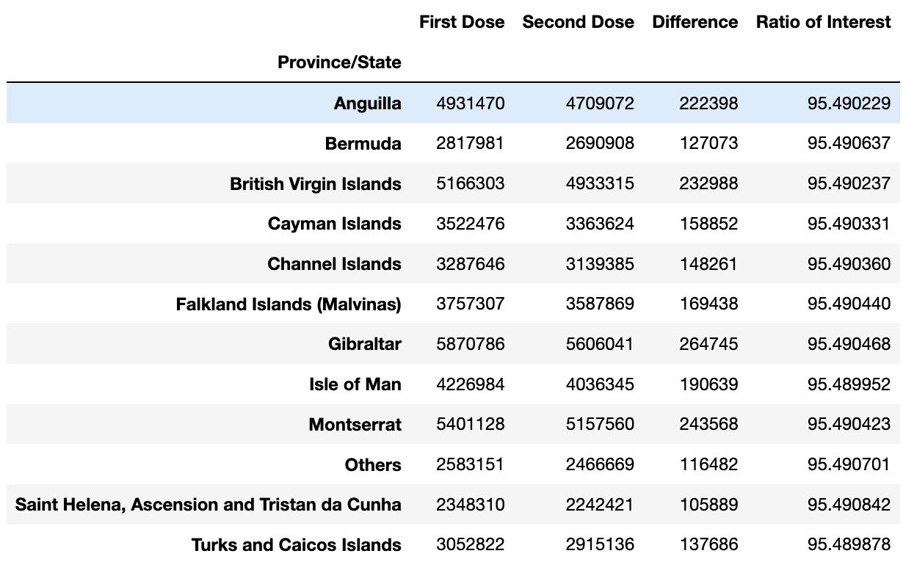
Vaccination Uptake
The uptake of 2nd dose vaccinations across all UK provinces against the first dose has been high, with all provinces recording a 95%+ ratio of 1st dose to 2nd dose.
The Province with the largest difference between 1st and 2nd dose is Gibraltar with 264,745 who are yet to have the 2nd dose.
It is not clear how these values relate to population, so whilst the ratio shows as high, when compared to their province total, it may be very low.
This should be determined to influence where the marketing campaign is targeted.

Slide 8
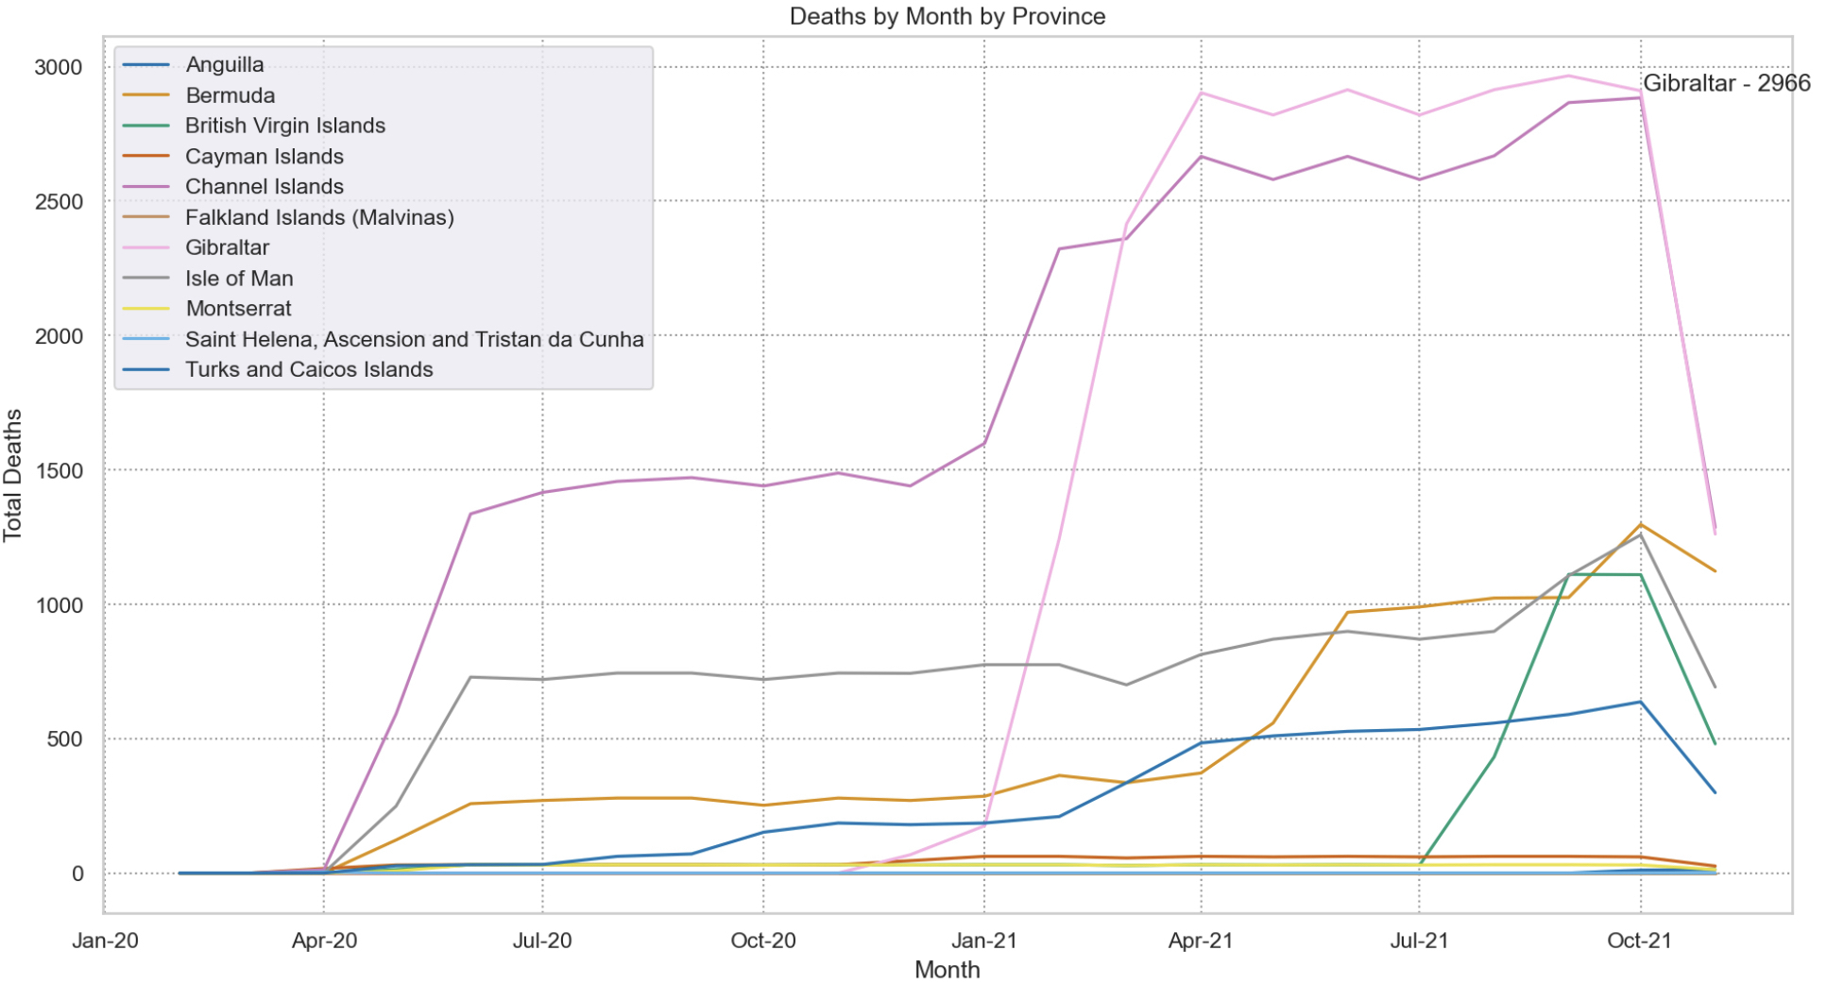
Cases / Deaths
Cases and Deaths for all provinces seem to follow a similar pattern, but it is too early to determine if Deaths have peaked.
The ‘Others’ province skews the data for the other provinces and when removed, it allows the ability to see these trends in more detail.
The Channel Islands and Gibraltar follow very similar progression for Deaths, but recording of data is stopped before it is possible to determine whether they have peaked.
Note some of the more remote provinces in the world have minimal deaths. Quantitative and qualitative analysis could be performed to identify if this was due to their own lockdown policies or those of the wider world.

Slide 9
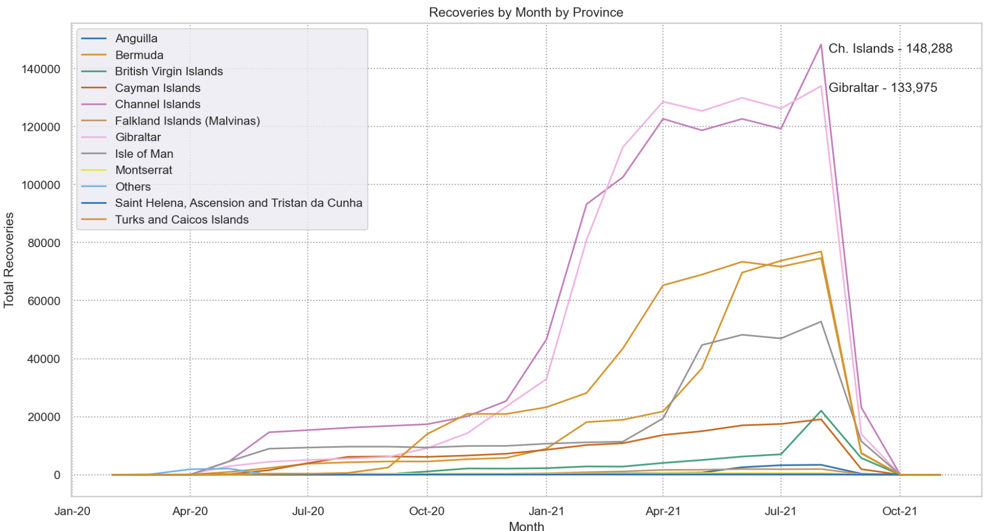
Recoveries
Similar to those who have died, those who have recovered seem to follow similar trajectories.
Again Channel Islands and Gibraltar have the highest recovery numbers, but in a strange outcome, the ‘Others’ Province records little to no recovery. Given the number of cases that the Other province has, it would be expected that it would skew the graph.

Slide 10
TWITTER

Slide 11
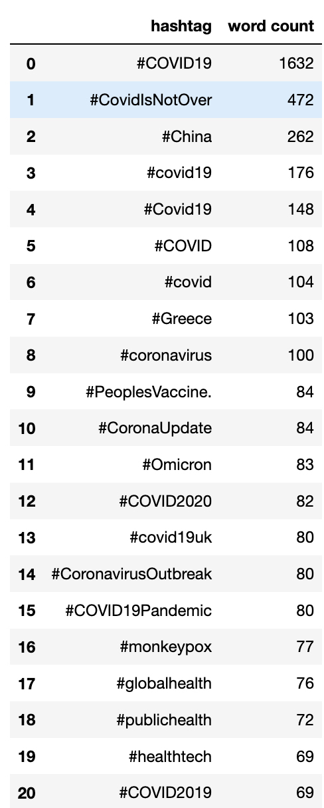
Twitter
Twitter shows that there are several variations of COVID-19 hashtags which is not unexpected. Without understanding the parameters of the data scraping, additional hashtags such as #lockdown, #savethenhs #sage might help determine also the mood of the public.
Further qualitative analysis should be performed on understanding the public, if there are any reasons why they would be reluctant to take the vaccination but to also know if there is any trust lost between the government and the public.
By understanding this qualitative data, the government may be able to adjust the marketing campaign accordingly to ensure that the public are more likely to take the vaccine, rather than it being mandated.

Slide 12
CONTINUAL IMPROVEMENT

Slide 13
Continual Improvement
Whilst Channel Islands and Gibraltar seem to be the key areas initially to target the marketing campaign, additional improvement can be made on the recommendations by:
Determining if the data is cumulative (rolling) or new cases every day
Validating the data points for causality between cases, hospitalisations, recovery and death.
Identifying the population from census data to determine % uptake of the vaccine.
More granular level detail on the provinces which make up Other
Identify the influences of social media on uptake by exploring other hashtags

